Slide 1
DG GROW ESPD
Exchange Data Model
v1.0
DG GROW
Unit R3
Brussels

Slide 2
ESPD Exchange Data Model
Modelling Approach
UBL-2.1
Core Criterion Data Model
Core Evidence
Data Model
ESPD Data Model

Slide 3
Criterion and Evidence
(ESPD Customisation)
Conceptual
(simplified)
Evidence
issuer
Core Evidence Data Model
Party
DocumentReference
sub
Criterion
Legislation
Core Criterion Data Model
Requirement
Response

Slide 4
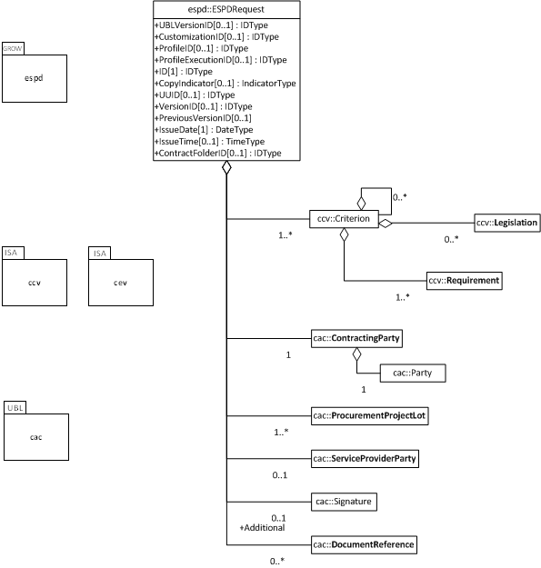
ESPDRequest
UML

Slide 5
Criterion
(ESPDRequest Customisation)
UML

Slide 6
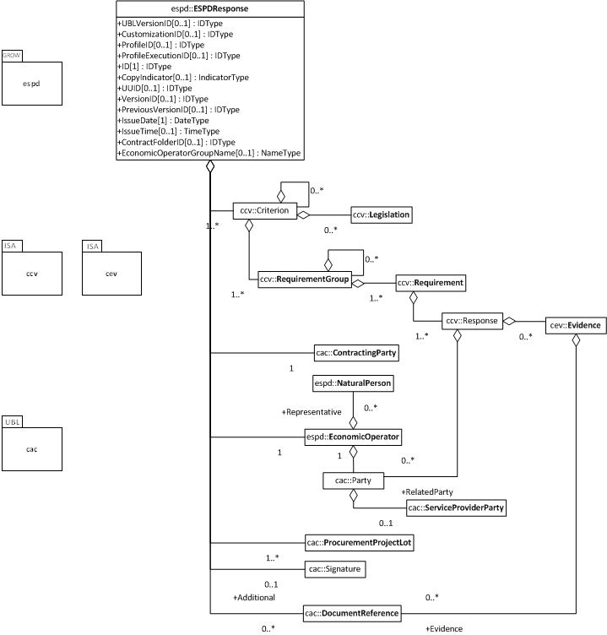
ESPDResponse
UML

Slide 7
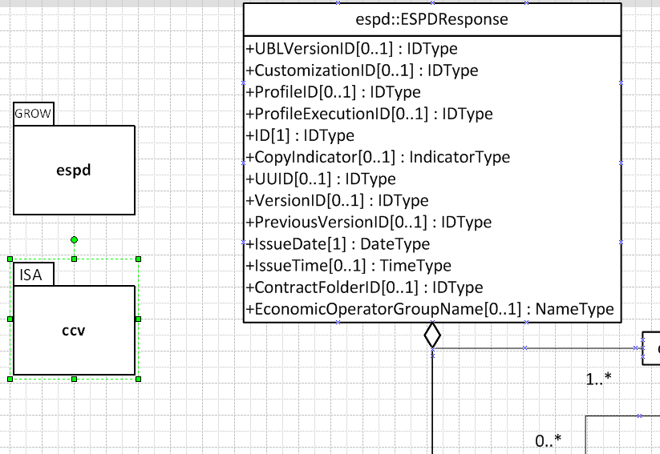
ESPDResponse (root details)
UML

Slide 8
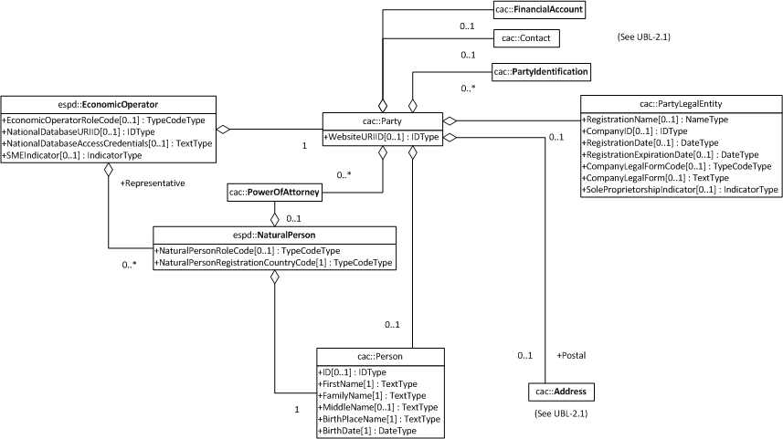
ESPD
Economic Operator
(details)
UBL-2.1 Syntax

Slide 9
Criterion and Evidence
(ESPDResponse Customisation)
UML

Slide 10
ESPD
Data Architecture
(simplified overview)
ESPD
Request & Response
import
ESPD
Aggregate Components
CCV
Core Criterion Vocabulary Aggregate Components
Core Evidence Vocabulary
Aggregate Components
UBL-2.1 CAC
Common Aggegate Components
imports
imports
import
ESPD
Common Basic Components
CCV-CBC
Core Criterion Vocabulary Common Basic Components
CEV-CBC
Core Evidence
Vocabulary Common Basic Components
UBL-2.1 Common Basic Components
imports
UN/CEFACT CCTS
reuse “as-is”

